Slide 1

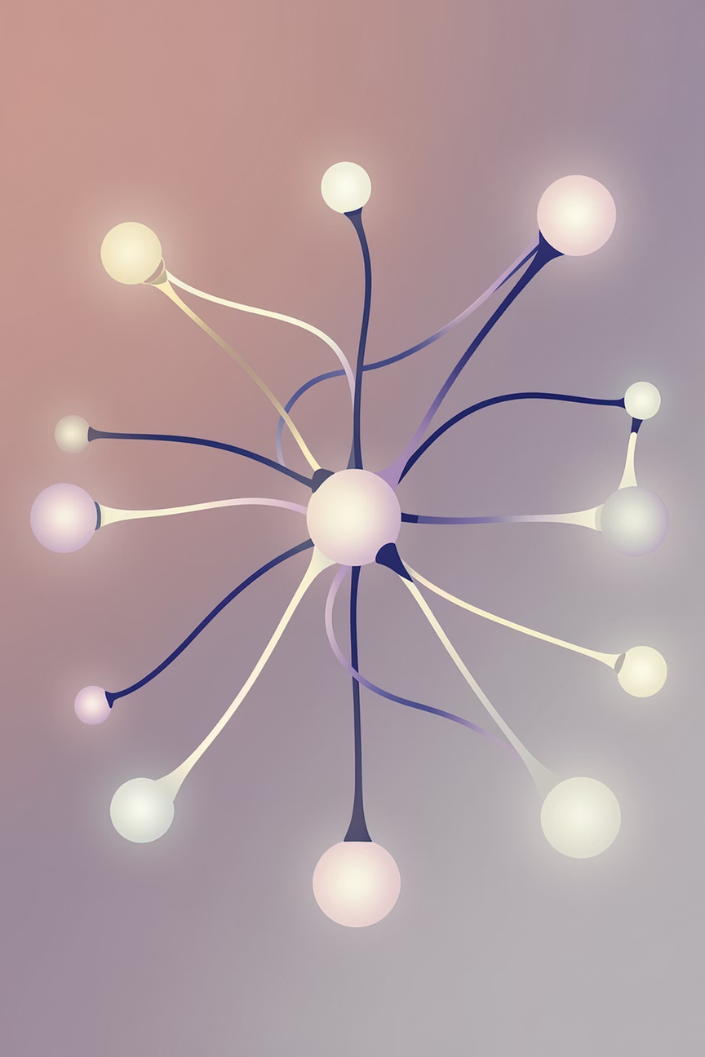

Classification by Backpropagation
Data Mining Technique using Neural Networks
DATA MINING
NEURAL NETWORKS
Notes:
1

Slide 2
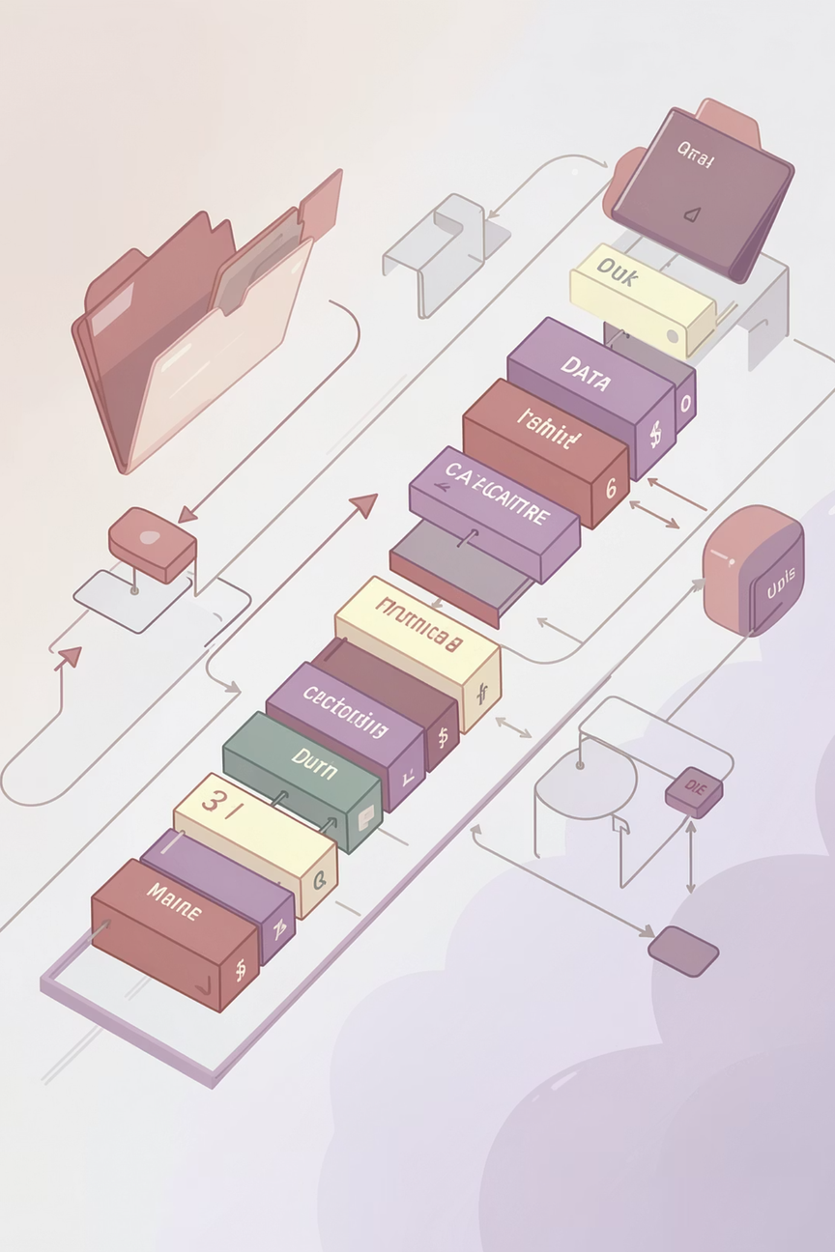
Introduction to Classification
Classification is a supervised learning method that assigns data objects to predefined categories. The model learns from labeled examples, then predicts the class of new, unseen data.
Supervised Learning
Trained on labeled data with known outcomes
Predefined Classes
Objects mapped to fixed categories
Prediction
Classifies new, unseen data accurately
Decision Systems
Widely used in automated decision-making
Notes:
2

Slide 3
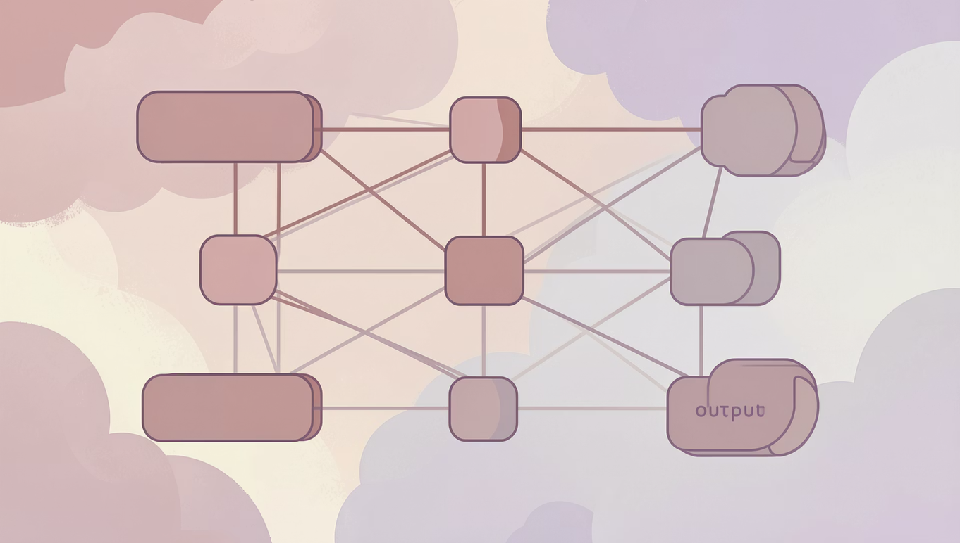
Concept of Neural Networks
Neural networks are computational models inspired by the human brain, consisting of interconnected processing units called neurons organized into layers.
Input Layer
Hidden Layer(s)
Output Layer
Receives raw feature data
Processes and transforms information
Produces the final class prediction
Notes:
3

Slide 4
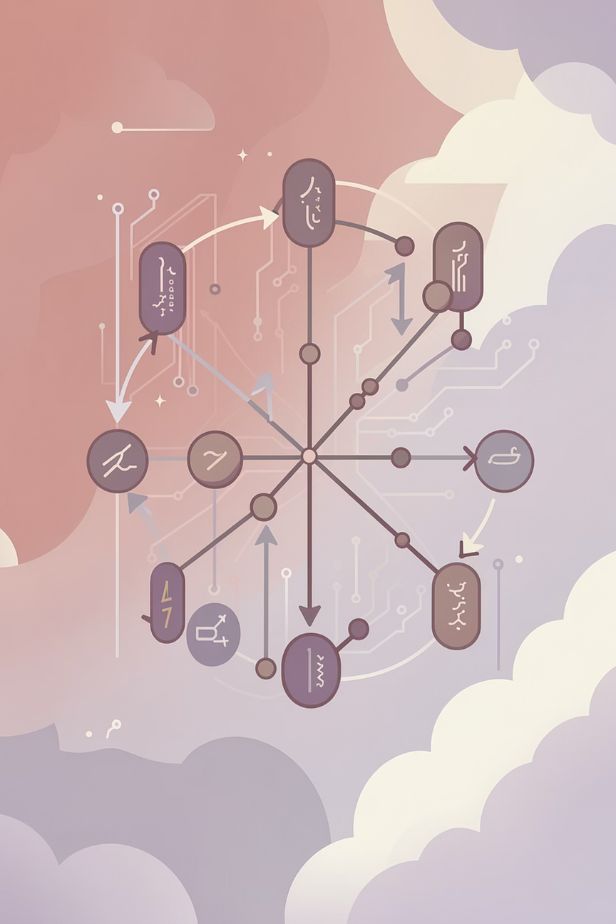
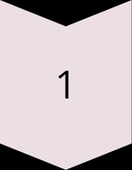
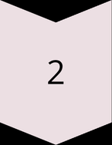
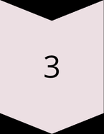
What is Backpropagation?
Backpropagation is the core learning algorithm used to train neural networks. It enables the network to learn from its mistakes by systematically reducing the gap between predicted and actual outputs.
Measure Error
Calculate difference between prediction and target
Propagate Backward
Send error signal back through layers
Adjust Weights
Update connection weights to reduce error
Notes:
4

Slide 5
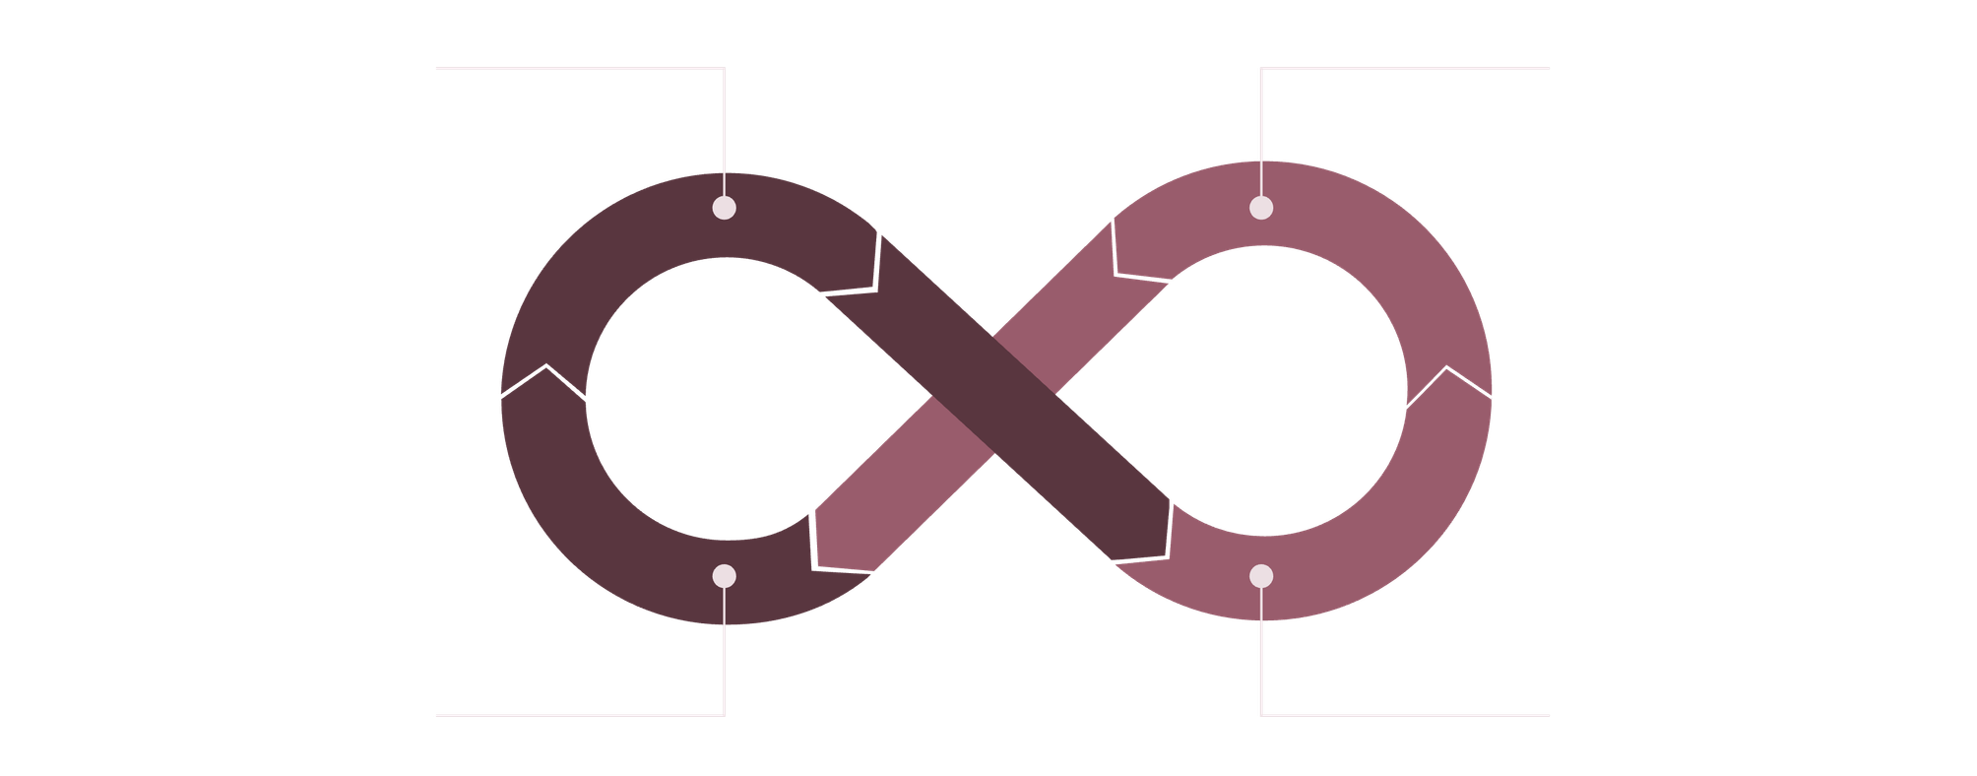
Working Principle
Backpropagation operates in two alternating phases, repeated over many training iterations to progressively improve accuracy.
Forward Pass
Compute Output
Update Weights
Backward Pass
The forward pass generates a prediction; the backward pass corrects it. This cycle repeats until the network converges on an optimal solution.
Notes:
5

Slide 6
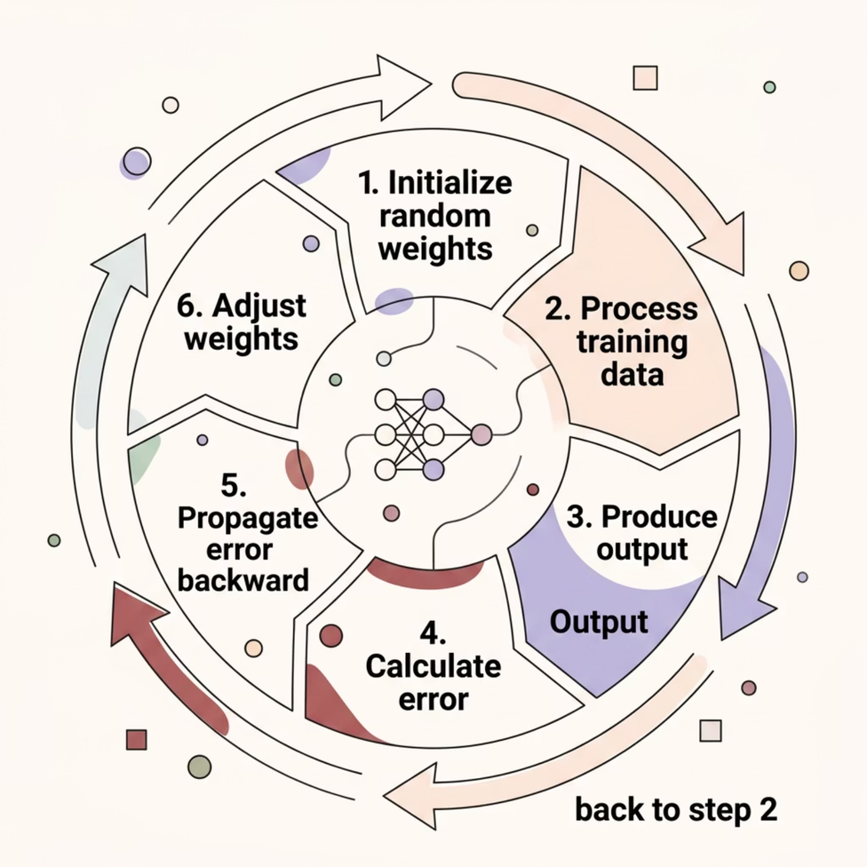

The Learning Process
The network begins with random weight values and refines them through repeated exposure to training data. Each iteration brings the model closer to accurate classification.
This cycle continues until the error falls below a threshold or a maximum number of epochs is reached.
Notes:
6

Slide 7
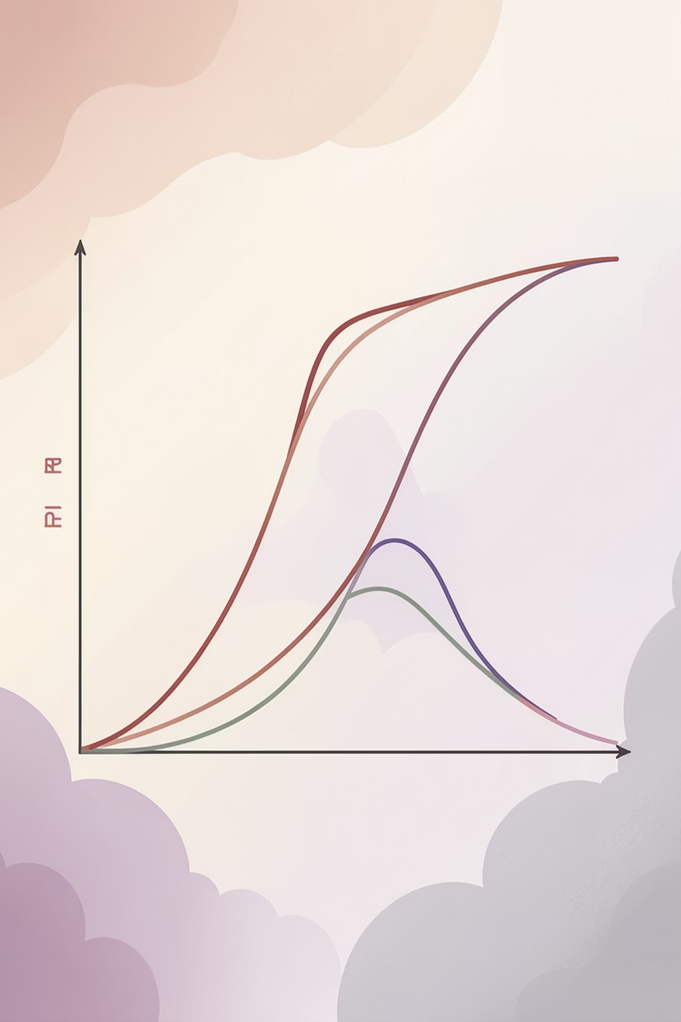


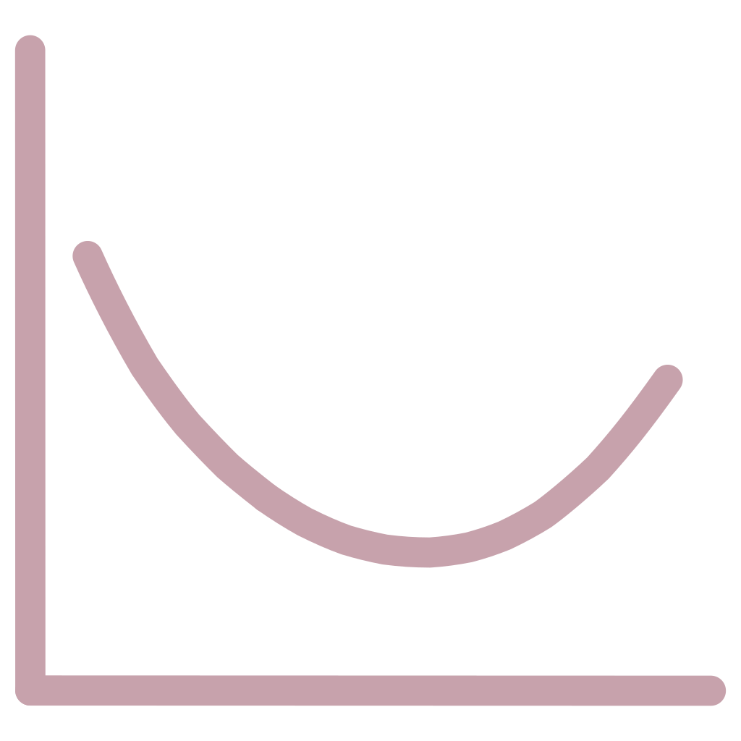
Role of Activation Functions
Activation functions determine whether and how strongly a neuron should fire. They introduce non-linearity, enabling the network to learn complex, real-world patterns.
Sigmoid
Maps output between 0 and 1 — ideal for probability-based classification
ReLU
Rectified Linear Unit — passes positive values, zero otherwise; widely used in deep networks
Tanh
Hyperbolic tangent — output ranges from −1 to +1, zero-centered for better convergence
Notes:
7

Slide 8
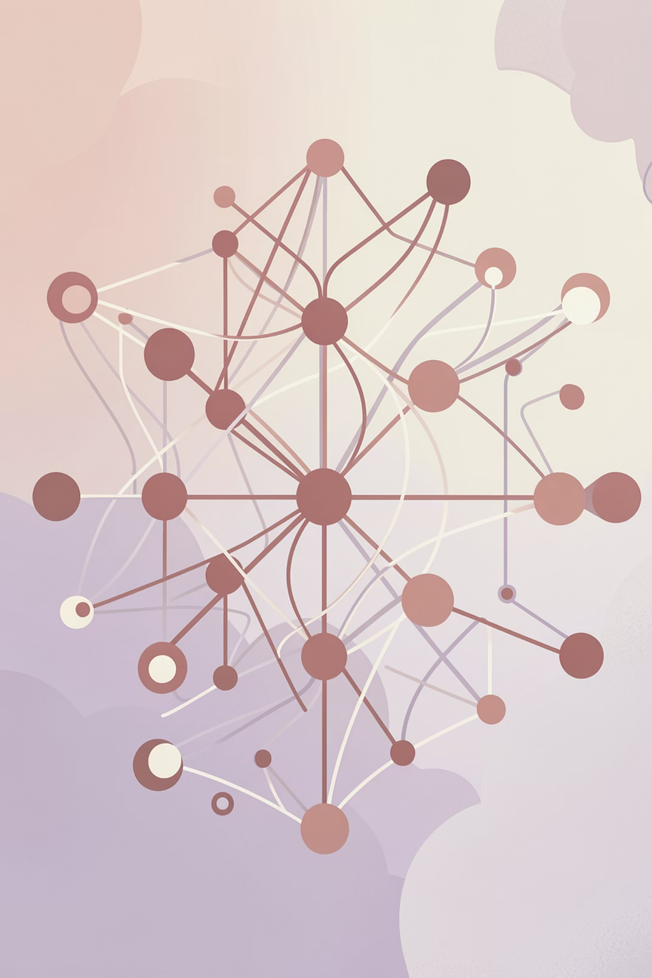
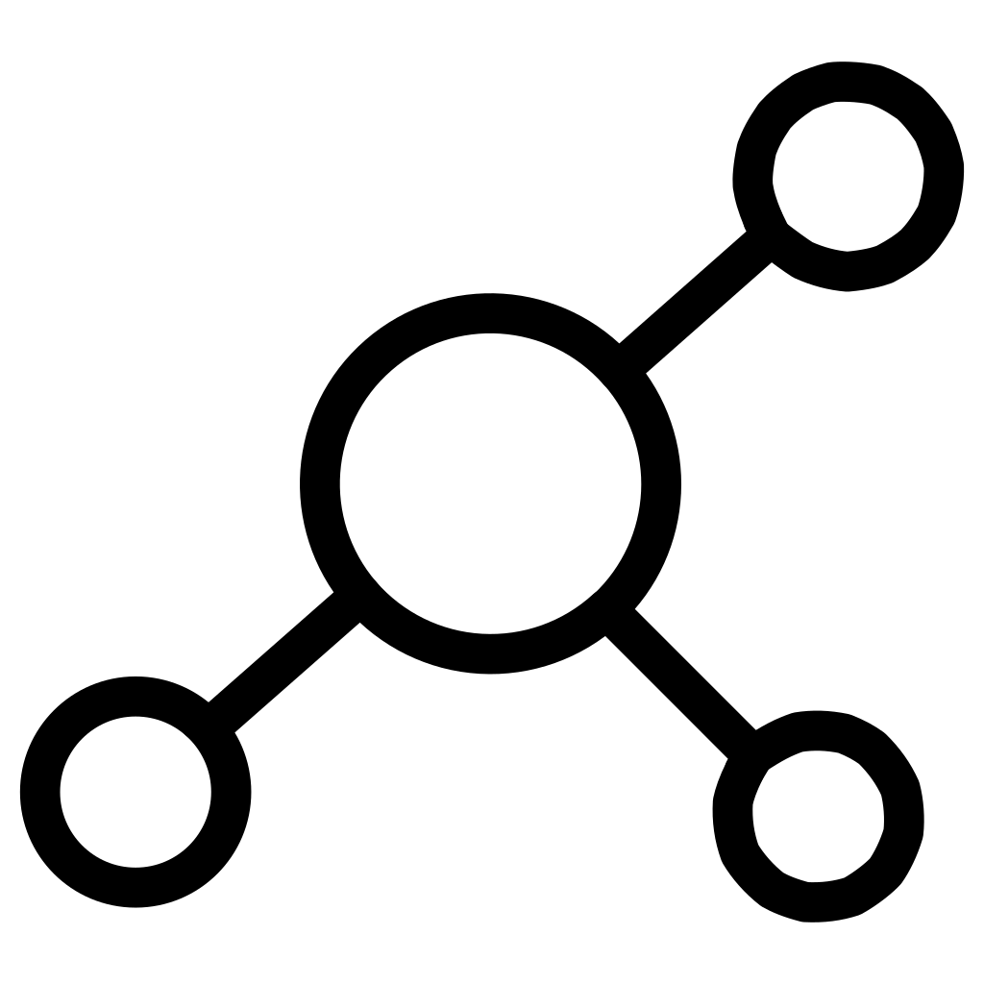



Advantages of Backpropagation
Handles Complexity
Models complex, non-linear data relationships effectively
High Accuracy
Delivers strong prediction performance on diverse datasets
Automatic Learning
Learns patterns directly from examples without manual rules
Versatile
Applicable across many domains — vision, speech, finance, medicine
Notes:
8

Slide 9
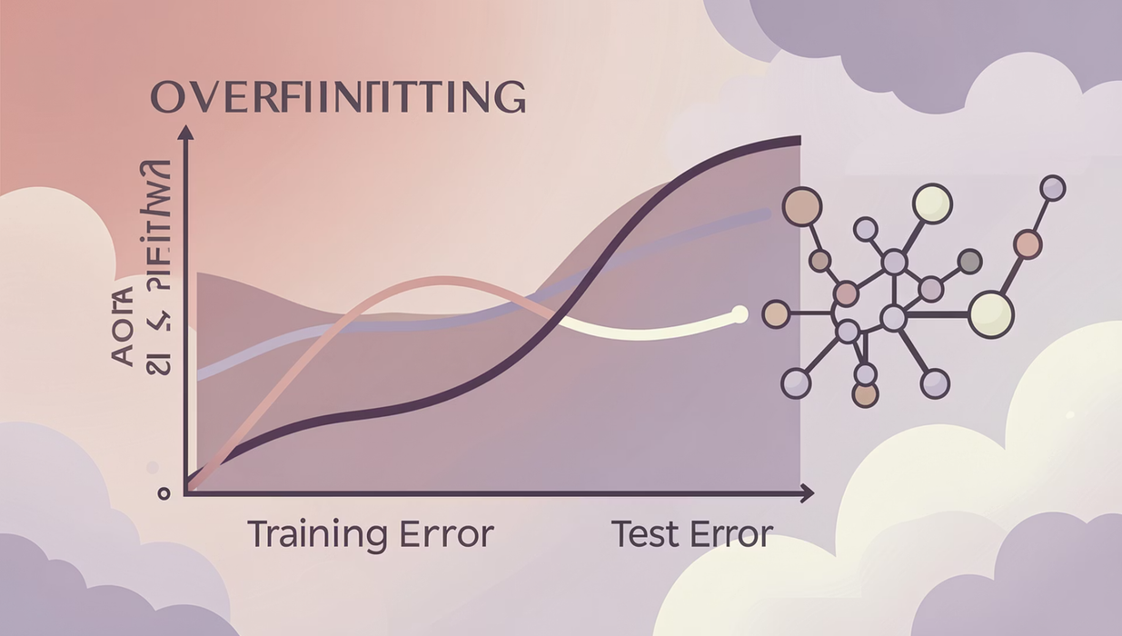
Limitations of Backpropagation
Despite its strengths, backpropagation has notable challenges that practitioners must address.
Data Hungry
Requires large volumes of labeled training data
Slow Training
Computationally expensive, especially for deep networks
Parameter Sensitivity
Performance depends heavily on learning rate and architecture tuning
Overfitting Risk
May memorize training data rather than generalize
Local Optima
Can get stuck in suboptimal solutions during training
Notes:
9

Slide 10

Applications & Conclusion
Real-World Applications
Key Takeaways
Email spam filtering — classifies messages as spam or legitimate
Backpropagation remains one of the most powerful classification techniques in data mining. It enables neural networks to learn efficiently from data, adapt to complex patterns, and deliver accurate predictions across a wide range of real-world problems.
Image & speech recognition — identifies objects, faces, and spoken words
Despite its limitations, backpropagation continues to underpin modern AI and machine learning systems.
Medical diagnosis — assists in detecting diseases from patient data
Financial forecasting — predicts market trends and credit risk
Notes:
10

Slide 11
THANK YOU
BY: Jahanvi Srivastava
(RA2311003011082)

